Slide 1

Intro to Maven

Slide 2
Agenda
Why Maven?
The Maven Way
Maven Basics
Multi-Module Projects
Web Projects
Integration Testing
Clean/Advanced Maven

Slide 3
What Is Maven?
Build tool (focused on JVM)
Convention over configuration
Structured project model
Build code reuse

Slide 4

Why Maven?

Slide 5
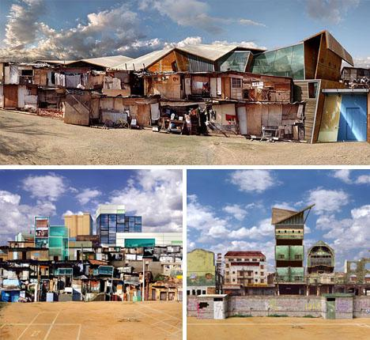
Shanty Town Builds
Rarely get focused attention
Haphazard areas of focus
Each is unique

Slide 6

Regular Structure
Approachable
Machine-readable
Codifies good practice
Supports collective ownership
Photo: Russ Allison Loar
http://bit.ly/14flwzd

Slide 7
Good Practices
Separate code, tests, resources
Platform independence
Declarative dependency management
Share resources via dependencies
Predictable directory structure
Test built artifacts

Slide 8
Why Not Maven?
General automation
Legacy code with intricate build incantations
Might be able to bridge with AntRun or custom plugins

Slide 9
The Maven Way
Don't fight Maven. You'll lose.
Maven is a box that turns source code into build artifacts
First, try to see how your problem fits into Maven's worldview
Next, you might want to write a plugin or use AntRun
If you're still struggling, you may want to consider another tool

Slide 10
Maven Basics

Slide 11
Creating a New Project
<?xml version="1.0" encoding="UTF-8"?>
<project xmlns="http://maven.apache.org/POM/4.0.0"
xmlns:xsi="http://www.w3.org/2001/XMLSchema-instance"
xsi:schemaLocation="http://maven.apache.org/POM/4.0.0
http://maven.apache.org/xsd/maven-4.0.0.xsd">
<modelVersion>4.0.0</modelVersion>
<groupId>com.example.maventraining</groupId>
<artifactId>simple</artifactId>
<version>1.0-SNAPSHOT</version>
</project>

Slide 12
Running Maven
mvn <phase or goal> [<phase or goal>...]

Slide 13
Maven Lifecycles
Clean
Default
Site

Slide 14
Default Lifecycle (Abridged)
Validate
Compile
Test
Package
Integration-test
Verify
Install
Deploy

Slide 15

Dependency Management
<dependencies>
<dependency>
<groupId>junit</groupId>
<artifactId>junit</artifactId>
<version>4.11</version>
<scope>test</scope>
</dependency>
</dependencies>
Coordinates: groupId, artifactId, version, and optional scope

Slide 16
Dependency Scopes
compile (default)
provided
runtime
test
system
import

Slide 17
Snapshot Versions
Good for intra-project dependencies during development
Will check for updates each time you build
Will break your build eventually outside a single source tree
x.x-SNAPSHOT

Slide 18
Release versions
Generated by the release plugin
Assumed immutable (cached aggressively)

Slide 19
Directory Layout
src/main/java | Application/Library sources
src/main/resources | Application/Library resources
src/main/webapp | Web application sources
src/test/java | Test sources
src/test/resources | Test resources
target | Build output

Slide 20

Super POM
The POM from which all other POMs inherit
Look here for defaults
http://maven.apache.org/ref/3.0.4/maven-model-builder/super-pom.html
Image source: examiner.com

Slide 21
Exercise
Build a simple library that outputs "Hello, World!". Write a HelloWorld class that outputs a String and a test that invokes it. Build and test your project with Maven.

Slide 22
More Basics
Plugins
Packaging

Slide 23
Plugins
Maven's main unit of modularity
How most of Maven's functionality is implemented and configured

Slide 24
Plugin Configuration
<build>
<plugins>
<plugin>
<artifactId>maven-compiler-plugin</artifactId>
<version>3.1</version>
<configuration>
<source>1.6</source>
<target>1.6</target>
</configuration>
</plugin>
</plugins>
</build>

Slide 25
Built-In Plugins
maven-compiler-plugin
maven-surefire-plugin
maven-dependency-plugin
maven-release-plugin

Slide 26
Common Plugins
AntRun
Cargo
Jasmine
Exec
PMD
Cobertura
Findbugs

Slide 27
Packaging
Defines the artifact type
Binds goals to phases
Core values: pom, jar, maven-plugin, ejb, war, ear, rar, par
Default is jar

Slide 28
Packaging Binds Goals to Phases
Phase | Goal
process-resources | resources:resources
compile | compiler:compile
process-test-resources | resources:testResources
test-compile | compiler:testCompile
test | surefire:test
package | jar:jar
install | install:install
deploy | deploy:deploy

Slide 29
Exercise
Add isEmpty check on a String, set source/target compiler versions to 1.6

Slide 30
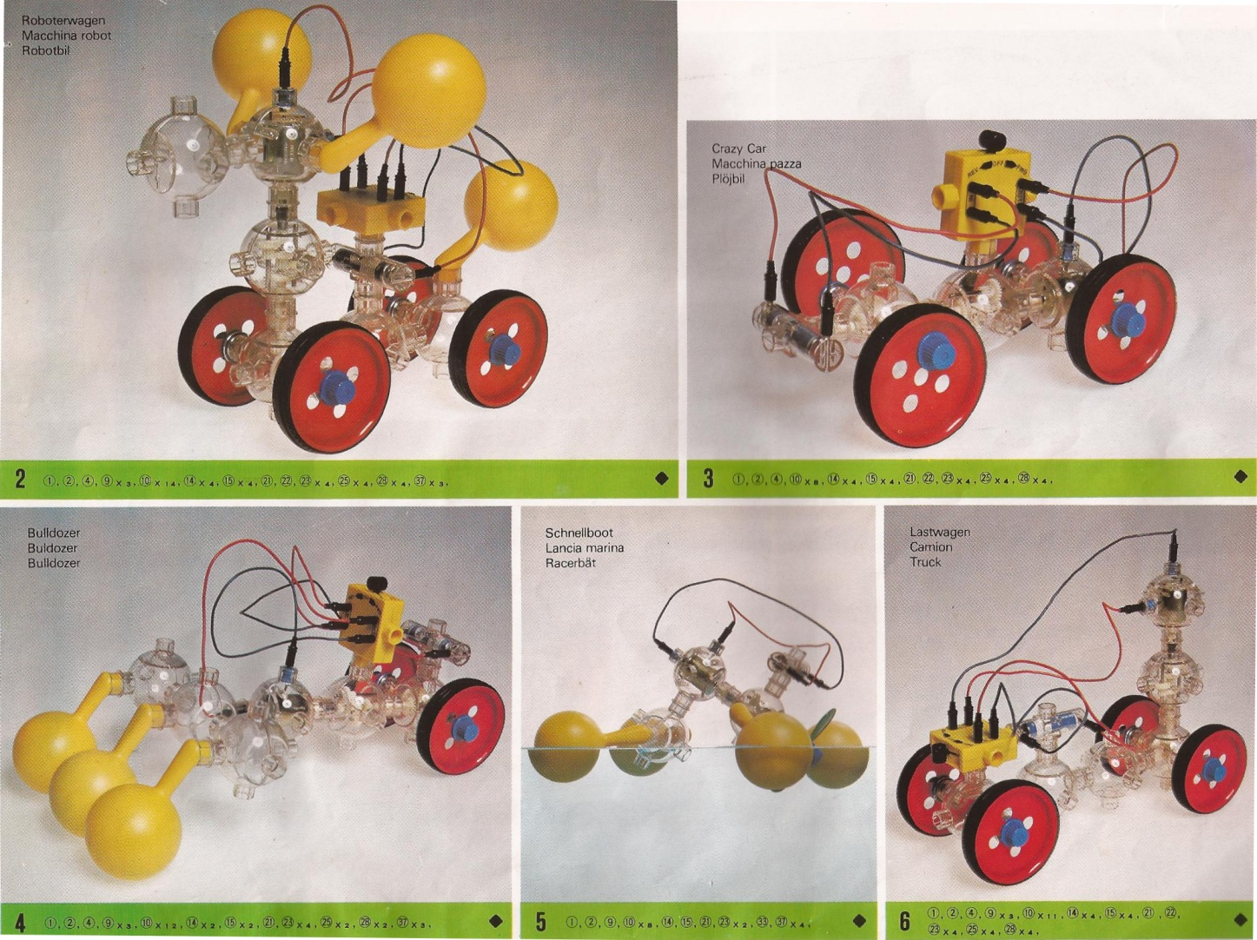
Multi-Module Maven
Why?
How?
Dependence vs. Inheritance
Naming

Slide 31
Why Multiple Modules?
Group related functionality
Isolate unrelated functionality
Organize dependencies
Unit for sharing code
Unit of packaging

Slide 32
Multi-Modules: How
Top-level pom packaging with modules
Optional parent in sub-modules

Slide 33
Modules
<modules>
<module>hello-util</module>
<module>hello-service</module>
</modules>

Slide 34
Parent
<parent>
<groupId>com.example.maventraining</groupId>
<artifactId>hello</artifactId>
<version>1.0-SNAPSHOT</version>
</parent>

Slide 35
Dependence vs. Inheritance
Use dependencies to share code, resources
Use inheritance to aggregate common settings

Slide 36
Naming
"There are only two hard things in Computer Science: naming, cache invalidation, and off-by-one errors." - almost Phil Karlton
All modules are top-level, referenced by groupId-artifactId
http://maven.apache.org/guides/mini/guide-naming-conventions.html

Slide 37
Exercise: Multi-Module
Now that we have a Hello utility, we'd like to use it to greet people on our roster of users. For each name on our roster, output "Hello, <name>!". While the Hello utility might be generally useful, this greeting service is specialized functionality, so it should go in its own module.

Slide 38
Bonus
Web modules
Integration testing with Cargo
Dependency management
Properties
Profiles

Slide 39
Web Modules
war packaging
Static resources in src/main/webapp
web.xml in src/main/webapp/WEB-INF

Slide 40
Exercise: Hello Web
We’d like to expose our HelloWorld utility as a web service. Write a simple servlet that extracts the name from the URL and serves the hello response as plain text.

